Slide 1

Human Activity Recognition (HAR)
Abolfazl Hasani
January 2024

Slide 2
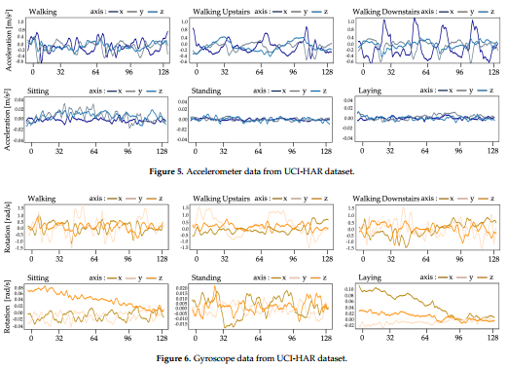
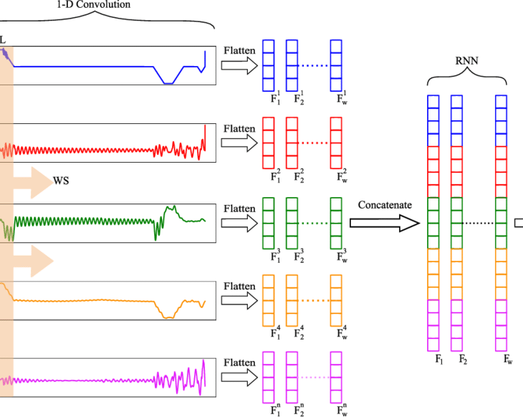
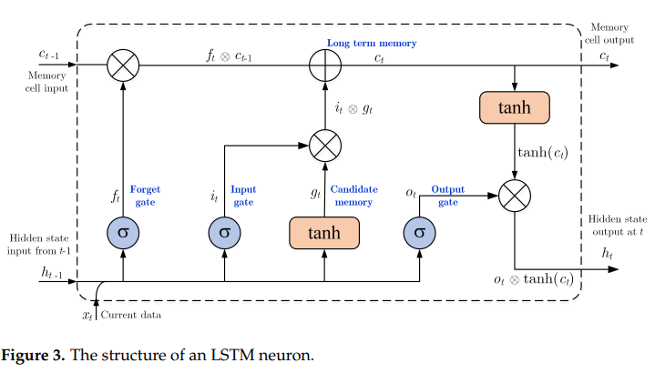
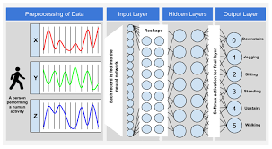
Agenda
What is HAR and why it is an important subject?
Goals of this project.
LSTM architecture.
UCI-HAR dataset.
Model implementation and CV.
Results.

Slide 3
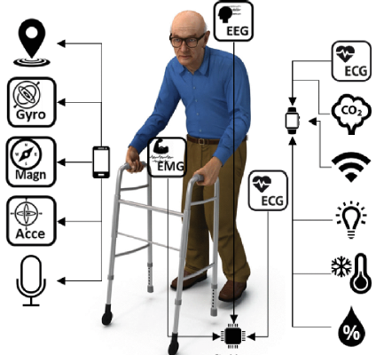
What is HAR?
Human activity recognition (HAR) is the process of using Artificial Intelligence (AI) to identify and label activities based on raw data collected from different devices.

Slide 4
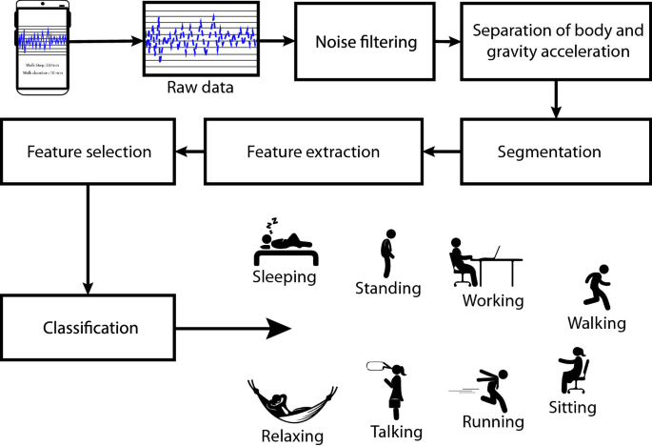
Why it is an important subject?
The AI community is interested in (HAR) because of its practical applications, including fall detection for elderly healthcare, exercise tracking in sports science, surveillance systems, and preventing office work syndrome.
HAR is currently a challenging research topic, primarily because of the widespread availability of cost-effective and low-power sensors in wearable devices.

Slide 5
Goals of this presentation
Implementation of the proposed hybrid deep learning model based on CNN and LSTM architectures.
The proposed LSTM-based HAR framework in this study enables the sensor data captured from the smartphone sensor to classify the activity performed by the smartphone user.

Slide 6
What is LSTM?
LSTM, or Long Short-Term Memory, is a type of recurrent neural network (RNN) architecture designed to overcome the limitations of traditional RNNs in handling long-term dependencies in sequential data. It has found extensive use in various applications, including natural language processing, speech recognition, and time-series prediction and classifications.

Slide 7
Problems with traditional RNNs
Traditional RNNs struggle with learning and retaining information over long sequences due to the vanishing gradient problem. As information is propagated through time steps, gradients can diminish, making it challenging for the network to capture and remember important patterns in the data.

Slide 8
Key Components of LSTM
Cell State: This represents the long-term memory and allows the network to carry information across many time steps.
Forget Gate: Determines what information from the cell state should be discarded or kept. It selectively forgets irrelevant information.
Input Gate: Regulates the update of the cell state by deciding which values to update. It involves a sigmoid layer to determine which values to update and a tanh layer to create a vector of new candidate values.
Output Gate: Controls what information from the cell state should be output to the next time step. It selectively outputs relevant information.

Slide 9
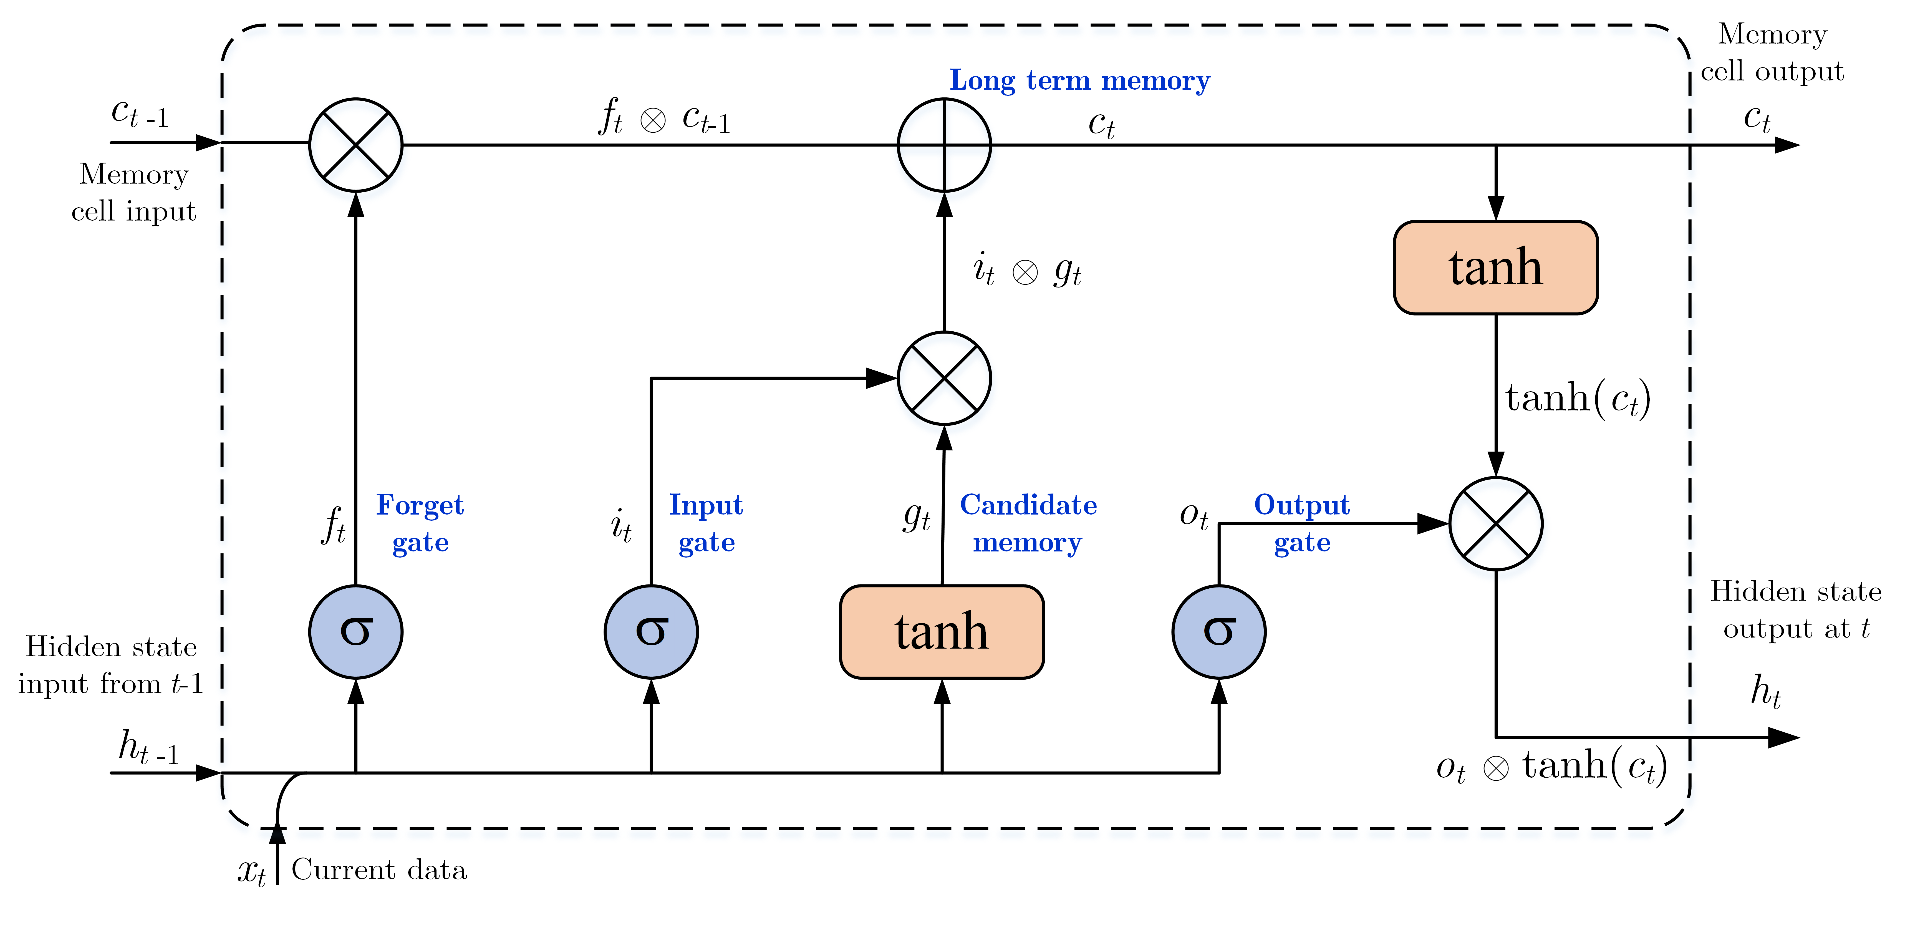
LSTM architecture for 1 cell

Slide 10
Benefits of LSTM
The LSTM architecture enables the network to capture long-range dependencies in sequential data by selectively updating and maintaining information over time. This makes it particularly effective in scenarios where context or dependencies are crucial, such as in natural language understanding or predicting trends in time-series data.

Slide 11
LSTM applications
LSTM has proven successful in various applications, including machine translation, speech recognition, and stock market prediction. Its ability to handle sequential data efficiently makes it a valuable tool in tasks where understanding context is essential.

Slide 12
UCI-HAR Dataset
The UCI-HAR (Human Activity Recognition Using Smartphones) dataset is a popular benchmark for evaluating human activity recognition (HAR) algorithms. It was collected in 2012 and contains data from 30 subjects performing 6 activities (walking, walking upstairs, walking downstairs, sitting, standing, and lying) while carrying a waist-mounted smartphone with embedded inertial sensors.

Slide 13
Activity distribution in UCI-HAR

Slide 14
Model architecture
The proposed 4-layer CNN-LSTM network utilizes tri-axial accelerometer and gyroscope data segments for activity recognition. It employs one-dimensional convolutional layers with ReLU activation function for feature extraction, followed by a max-pooling layer to reduce computational costs and dropout layer are added to prevent overfitting. Flattening layers convert matrix representations to vectors, The output is processed by an LSTM layer to capture temporal dynamics which is followed by another dropout layer. A fully connected layer, followed by a SoftMax layer to return identification, is the final layer.
This comprehensive architecture ensures efficient feature extraction and temporal modeling, enhancing its effectiveness in diverse applications, from health monitoring to motion analysis.

Slide 15
Model architecture summary

Slide 16
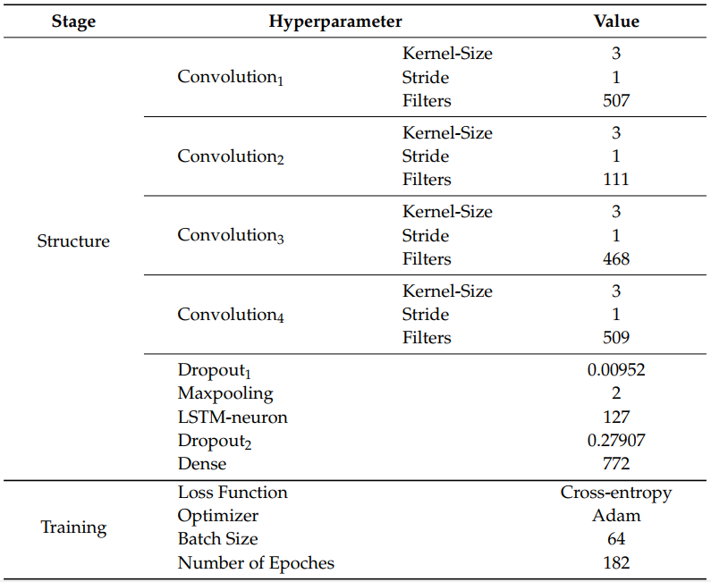
Model hyperparameters summary
Hyperparameters like filter number, kernel size, pool size, and dropout ratio were optimized using Bayesian techniques.

Slide 17
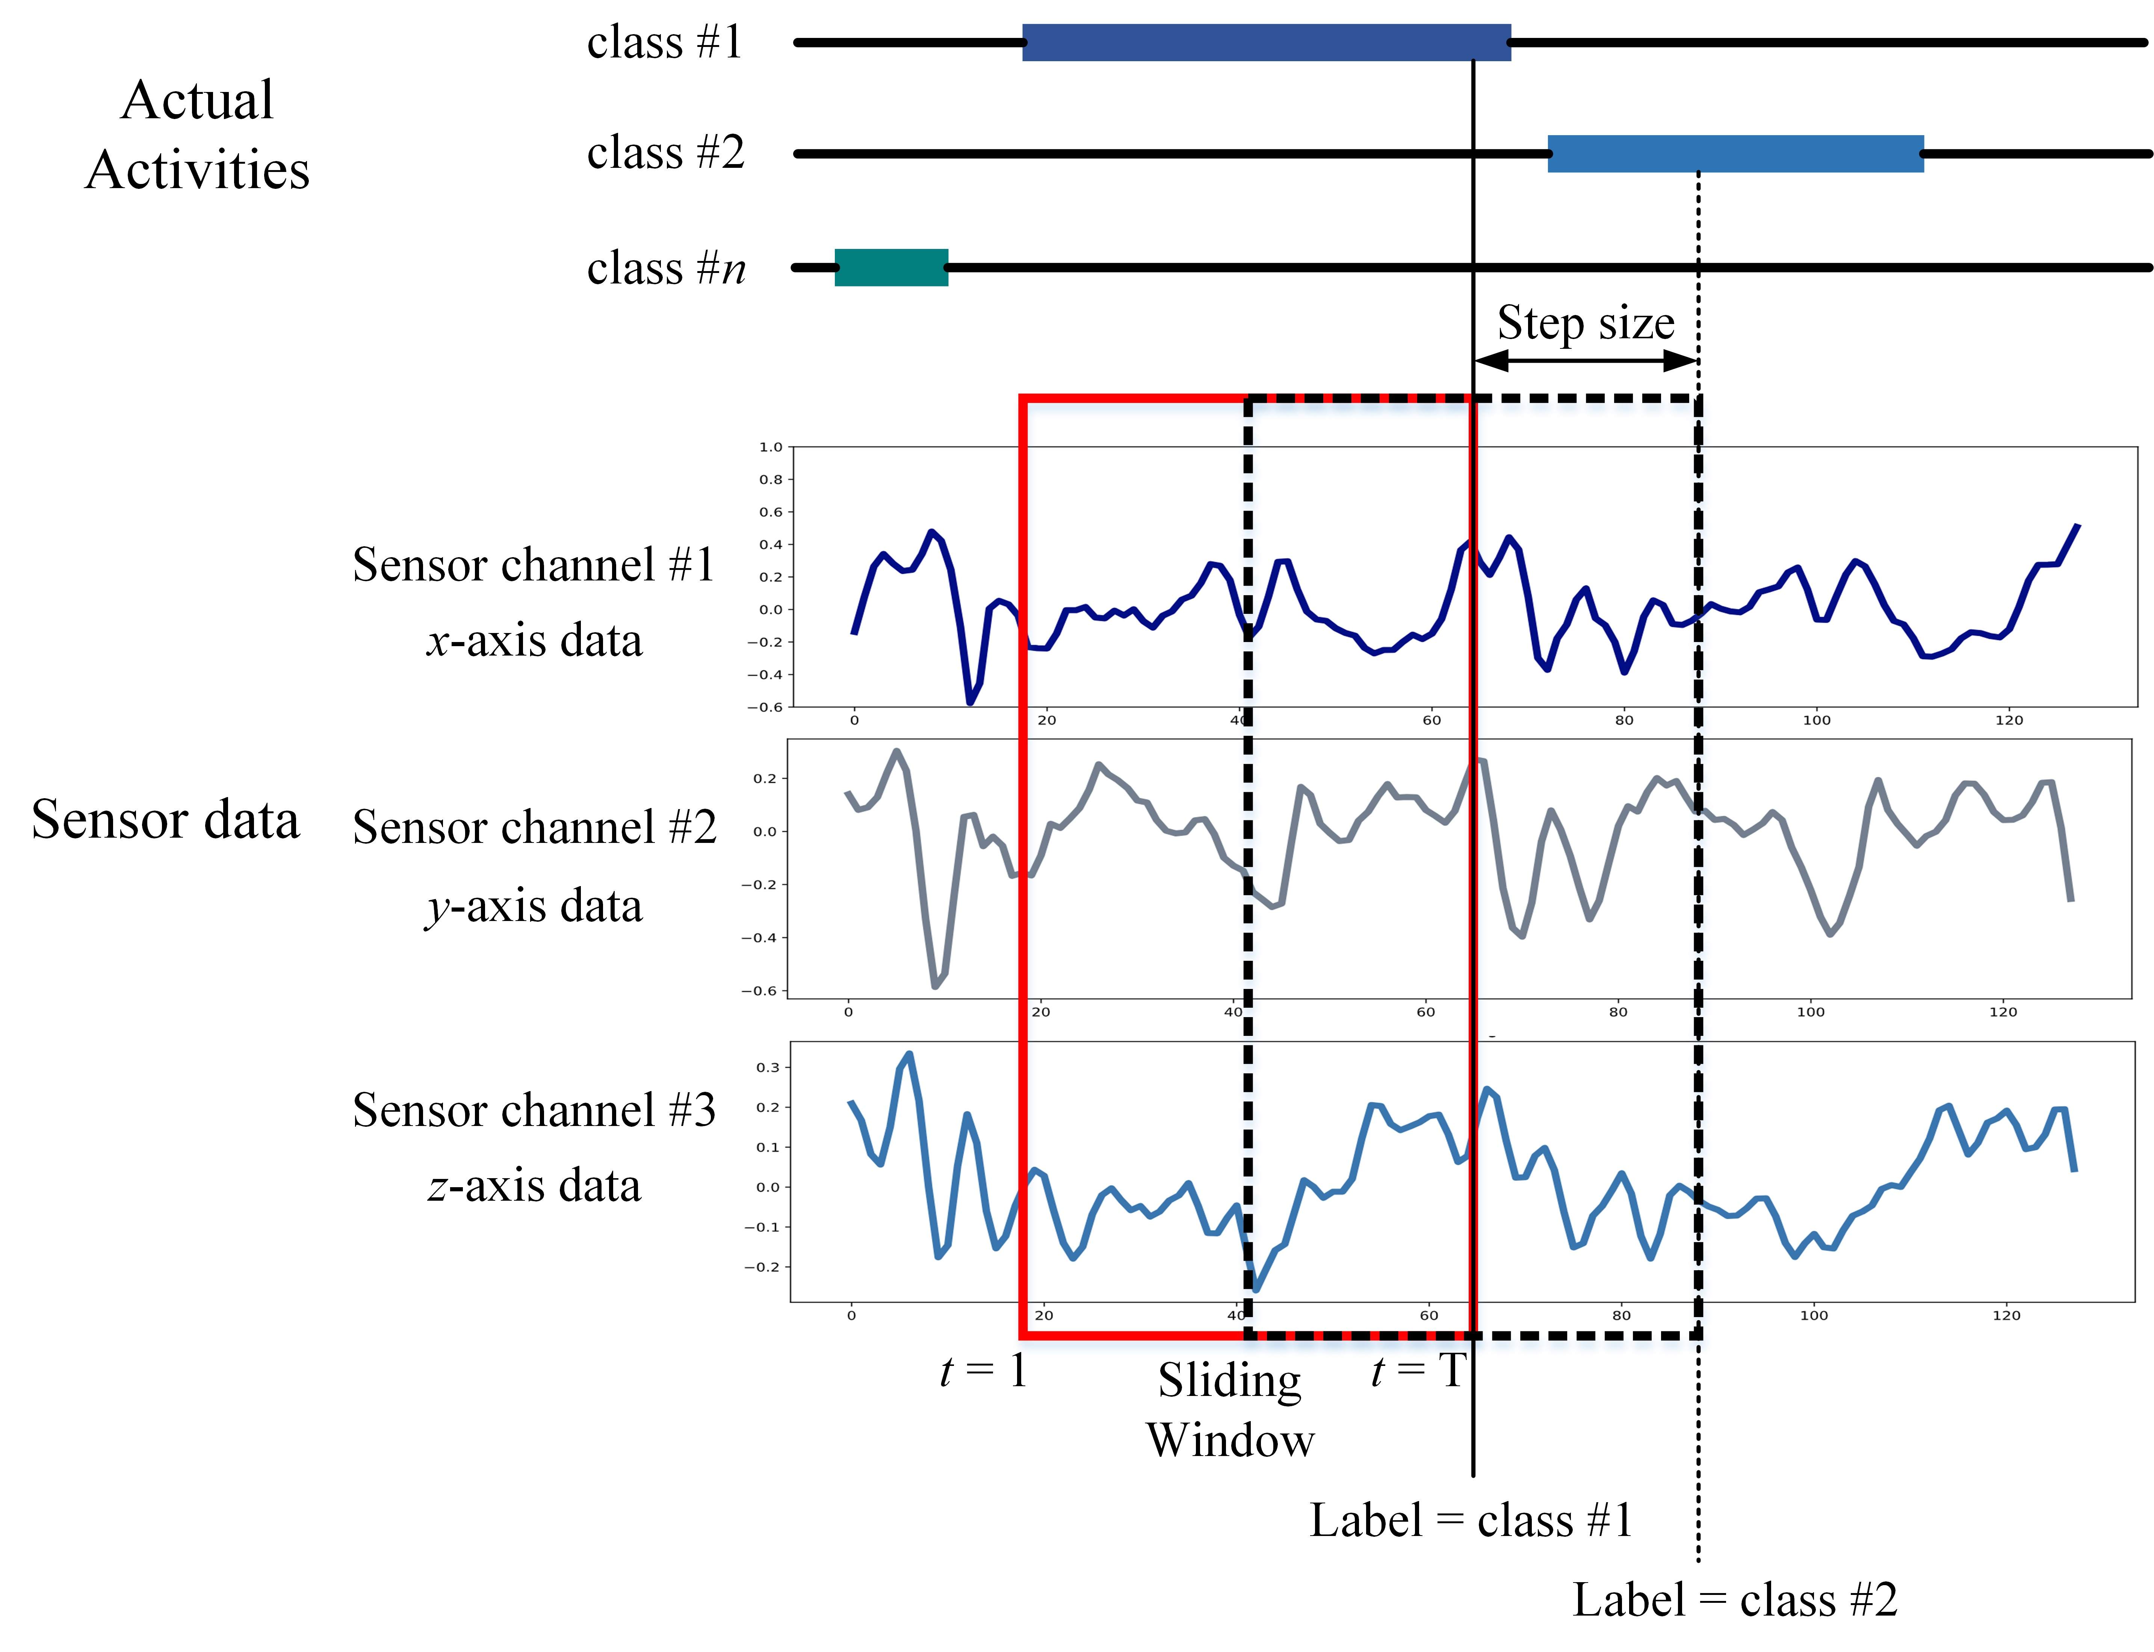
Sampling Generation Process
Temporal windows are often used in sensor-based Human Activity Recognition (HAR) studies. The overlapping temporal window (OW) is commonly employed but introduces bias with a 50% overlap between successive windows. In contrast, the non-overlapping temporal window (NOW) reduces bias but yields a limited number of samples as windows do not overlap.

Slide 18
Validation Protocol
In sensor-based Human Activity Recognition (HAR), the goal is to create a model that generalizes well across different subjects. For this, a subject-specific cross-validation protocol, known as Leave-One-Subject-Out (LOSO), is employed. LOSO involves using samples from all subjects for training, while systematically excluding one subject at a time to shape the training data. The excluded subject's samples are then used to evaluate the trained model, Also a 10-fold cross-validation protocol for time-series is employed to evaluate the model in different training periods.

Slide 19
Results
Obtained results by the authors of the article
Obtained results in this presentation
Sampling Generation process
NOW | OW
0.9876 ± 0.00500 | 0.9939 ± 0.00248 | 10-fold CV | Validation protocol
0.9394 ± 0.08190 | 0.9670 ± 0.03516 | LOSO CV
Sampling Generation process
NOW | OW
0.9721 ± 0.0279 | 0.9753 ± 0.0347 | 10-fold CV | Validation protocol
0.9835 ± 0.0076 | 0.9910 ± 0.0080 | LOSO CV

Slide 20

Thank you
Abolfazl Hasani
Abolfazl.hasani@aut.ac.ir

